Slide 1
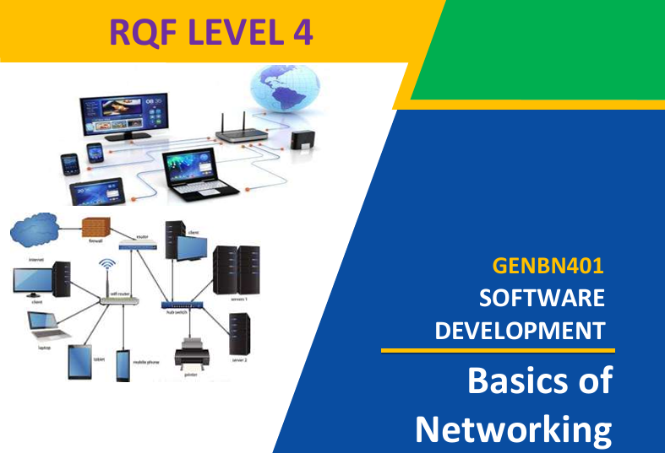
Web application development
Lecture 1
By: Trainer NIZEYIMANA Eraste

Slide 2

1.1.1.: Description of network concepts and technologies
Network: A network is a system of interconnected devices (like computers, phones, printers) that communicate and share resources, data, and services, using physical cables or wireless signals.
The computer on a network may linked through cables, telephone lines, radio waves, satellites, or infrared light beams.

Slide 3
Network classifications/types:
Classifying network by components roles:
Networks can be classified into different categories based on various criteria, including their size, scope, purpose , and architecture.

Slide 4
Some common network classifications:
based on Size:
Personal Area Network (PAN): A small network typically within a range of a few meters, used for connecting personal devices like smartphones, laptops, and tablets.
Local Area Network (LAN): Covers a limited geographic area, such as a home, office, or campus. LANs connect devices like computers, printers, and servers.

Slide 5
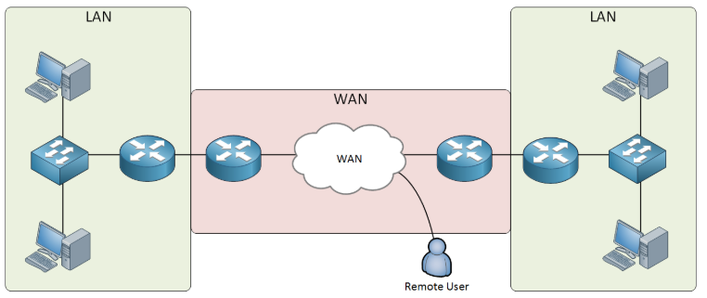
4. Metropolitan Area Network (MAN): Larger than a LAN but smaller than a WAN, covering a city or a large campus. MANs are used by organizations with multiple locations in a city.
5. Wide Area Network (WAN): Connects multiple Local Area Networks (LANs) and devices over large geographical areas (cities, countries) to share resources, data, and applications

Slide 6
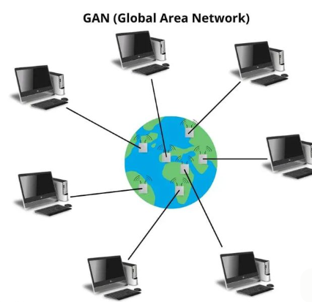
6. Global Area Network (GAN): A network that covers a global or international scale, often using satellite links and undersea cables. The internet can be considered a GAN.

Slide 7
Based on Purpose:
Public Network: Open to the public, such as the internet, where anyone can access and use its resources.
Private Network: Restricted to a specific organization, group, or individuals. Examples include corporate intranets and private cloud networks.
Hybrid Network: Combines elements of both public and private networks, often for security and cost considerations.
Peer-to-Peer (P2P) Network: Devices in this type of network communicate directly with each other without a central server.

Slide 8
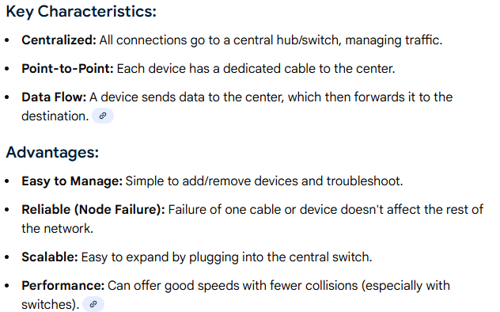
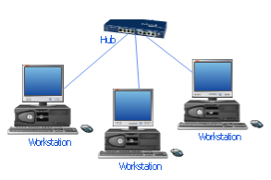
Based on Topology:
Star Topology: Devices connect to a central hub or switch.

Slide 9
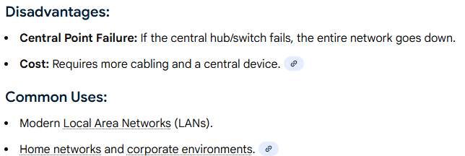

Slide 10
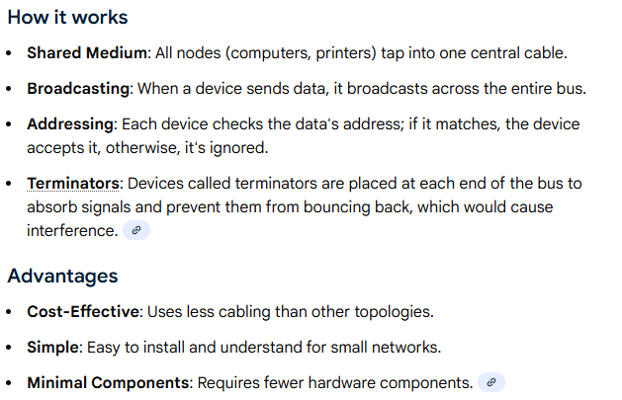
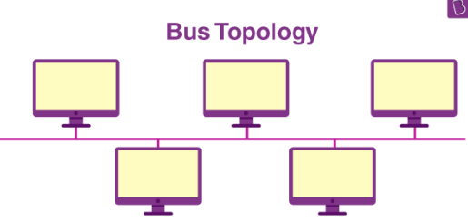
2. Bus Topology: A bus topology is a simple network setup where all devices connect to a single, shared cable

Slide 11
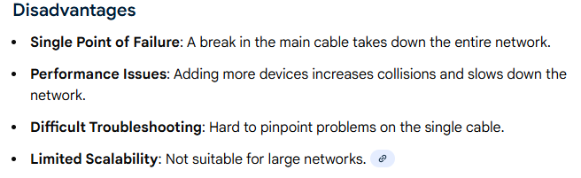

Slide 12
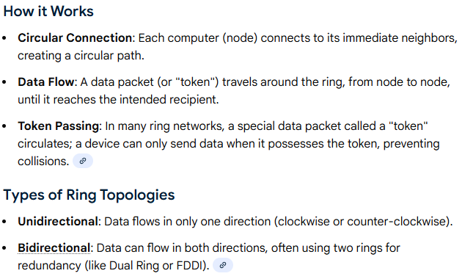
3.Ring Topology: a network setup where devices connect in a closed circle, with each device linked to exactly two neighbors, forming a continuous loop for data to travel

Slide 13
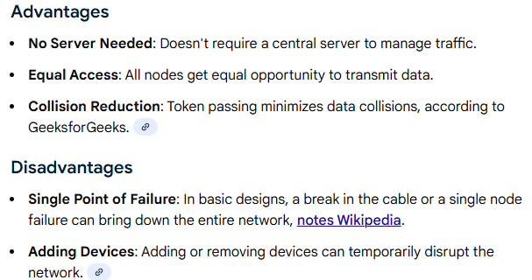
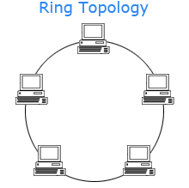

Slide 14
Mesh Topology: Devices connect to multiple other devices, creating redundancy.
Hybrid Topology: A combination of two or more different topologies.

Slide 15
Based on Ownership and Control:
Public Network: Owned and operated by a public entity or organization and accessible to anyone.
Private Network: Owned and operated by a specific organization, restricting access to authorized users.
Community Network: Shared by a specific community or group.
Cooperative Network: Jointly owned and operated by multiple organizations

Slide 16
Based on Network Services and Applications:
Data Network: Primarily used for data transmission and communication.
Voice Network: Designed for voice communication, such as traditional telephone networks (PSTN) Public Switched Telephone Network and Voice over IP (VoIP) networks.
Video Network: Focused on transmitting video content, including cable TV networks
IoT Network: Supports the connectivity of Internet of Things (IoT) devices, sensors, and machines.

Slide 17
Based on Architecture:
Client-Server Network: Devices are categorized as clients (requesters) and servers (providers of services or resources).
Peer-to-Peer (P2P) Network: Devices communicate directly with each other without a central server.
Data Sharing: Networks facilitate the sharing of data and resources.
Resource Sharing: Devices and resources such as printers, scanners, and storage devices can be shared across a network
Remote Access: With network connectivity, users can access data and applications from remote locations

Slide 18
Advantages of Networks:
Communication: Networks enable efficient communication between individuals, devices, or systems.
Resource Sharing: Networks allow for the sharing of resources such as files, printers, and software applications.
Centralized Data Management: In computer networks, data can be stored centrally, making it easier to manage and backup.
Remote Access: Networks enable remote access to resources and data, allowing individuals to work from different locations and enhancing flexibility.
Global Connectivity: The internet is a global network that provides access to information and services worldwide

Slide 19
Disadvantages of Networks:
Security Risks: Networks can be vulnerable to security threats such as hacking, viruses and malware.
Maintenance Costs: Networks require ongoing maintenance, including hardware upgrades, software updates, and security measures.
Bandwidth Limitations: In data networks, bandwidth limitations can lead to slow data transfer speeds.
Technical Issues: Networks can experience technical problems.
Downtime: Network failures or outages can disrupt communication and business operations.

Slide 20
Internet: The global network that connects millions of computers and devices worldwide, enabling communication, information sharing, and online services.
Intranets and Extranets: An intranet is a private network that is accessible only to an organization's staff.
It is designed to facilitate communication, collaboration, and access to internal resources and information. An extranet, on the other hand, extends the intranet to external users such as partners, vendors, and customers.

Slide 21
Advantages of Networks:
Communication
Resource Sharing
Centralized Data Management
Remote Access
Redundancy and Reliability
Redundancy and Reliability
Resource Optimization
Global Connectivity

Slide 22
Disadvantages of Networks:
Security Risks
Complexity
Maintenance Costs:
Privacy Concerns
Downtime
Bandwidth Limitations
Technical Issues
Application of network

Slide 23
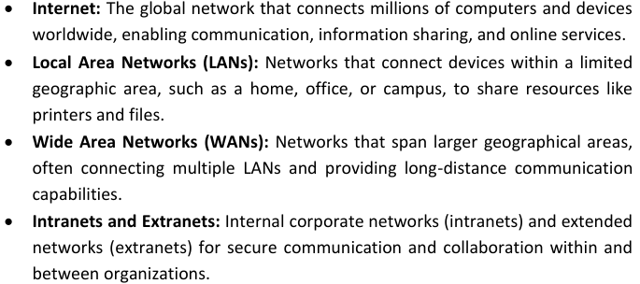
Here are some common applications of networks:
Computer Networks:

Slide 24
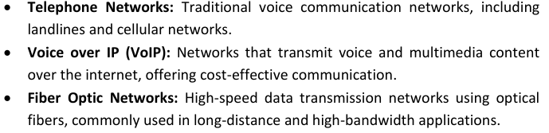
Telecommunications:

Slide 25
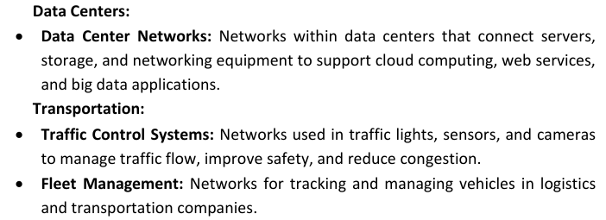

Slide 26
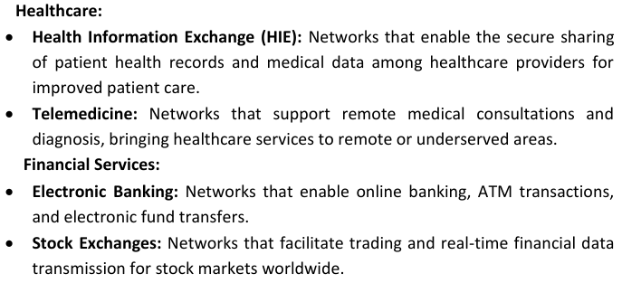

Slide 27
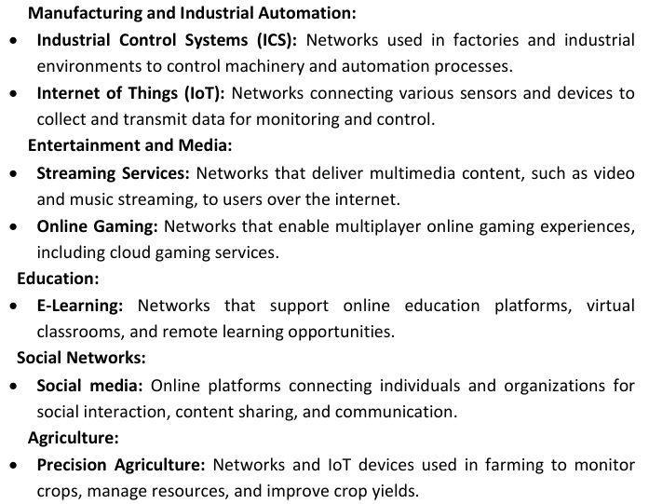

Slide 28
Smart Cities:
Public Wi-Fi
Network technologies
Ethernet
Wi-Fi (Wireless LAN)
Bluetooth
Cellular Networks(It includes generations like 2G, 3G, 4G, and 5G,)
IP (Internet Protocol) : IP is a fundamental network protocol that governs how data packets should be addressed and routed across the internet. IPv4 (Internet Protocol version 4) and IPv6 (Internet Protocol version 6) are the most commonly used versions.
TCP/IP (Transmission Control Protocol/Internet Protocol): TCP/IP is a protocols used for communication over the internet and local networks. It includes protocols like HTTP, FTP, SMTP, and DNS, which enable various network services.

Slide 29
9. DNS (Domain Name System): DNS is a technology that translates human readable domain names (e.g., www.example.com) into IP addresses (e.g., 192.168.1.1). It's essential for browsing the internet.
10. Firewalls: Firewalls are security devices or software that protect networks by monitoring and controlling incoming and outgoing network traffic.

Slide 30
End Devices
• Computers.
• Mobile Devices
• Printers
• IP Phones
• IoT Devices: Sensors, cameras, and other Internet of Things (IoT) devices.
• Networking Hardware: • Router: A device that connects different networks
• Switch: A device that connects devices within a local network and efficiently forwards data packets based on MAC addresses.
• Data Centers: Facilities housing network equipment, servers, and storage devices for centralized data processing and storage.
• Hub: An older networking device that broadcasts data packets to all connected devices.
• Access Point (AP): Facilitates wireless connectivity by allowing devices to connect to a wired network wirelessly (Wi-Fi).

Slide 31
• Firewall: A security device or software that monitors and controls network traffic, often used to protect against unauthorized access and threats.
• Modem: Converts digital data from a network into a format suitable for transmission over specific types of media (e.g., DSL, cable, fiber).
• Gateway: Acts as an entry and exit point between different networks, translating data formats and protocols.
• Network Infrastructure:
• Cabling: Includes Ethernet cables (e.g., CAT6), fiber-optic cables, and coaxial cables for wired connections.
• Wireless Infrastructure: Access points, wireless controllers, and antennas for Wi-Fi networks.
• Network Servers: Systems responsible for hosting applications, files, and services on the network.

Slide 32
Identification of network Materials, Tools and Equipment
Tools: In networking, tools refer to various software and hardware utilities used for the setup, management, troubleshooting, and optimization of network systems.
Equipment : In networking, equipment refers to the hardware devices used to establish, manage, and support a network's infrastructure.
Materials : In networking, materials refer to the physical components and resources used to build and maintain the network infrastructure.

Slide 33
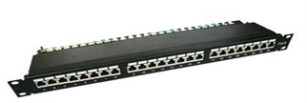

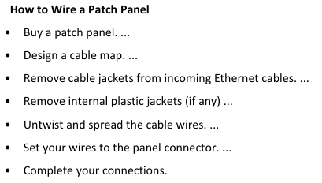
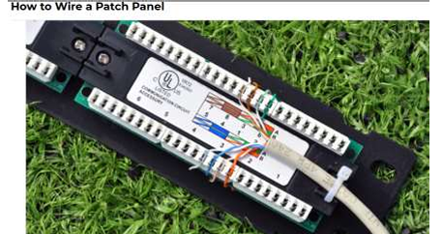
Examples of Networking Tools
Cutting Tools and Stripping tools
Drilling Tools
Fixing Tool
Patching Panel

Slide 34
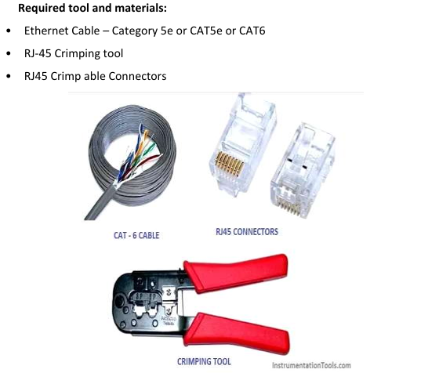
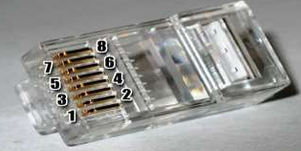
There are four pairs of wires in an Ethernet cable, and an Ethernet connector (8P8C) has eight pin slots. Each pin is identified by a number, starting from left to right, with the clip facing away from you.

Slide 35
There is two kinds of Ethernet cable is used for communication.
• Straight Through
• Cross over cable

Slide 36
Equipment
UPS: An uninterruptible power supply
Inverter: An inverter converts the DC voltage to an AC voltage.
Computer
Switch
Glue gun
Rack: What is a Network Rack? Known by many names, a network rack is a metal frame chassis that holds, stacks, organizes, secures and protects various computer network and server hardware devices.

Slide 37
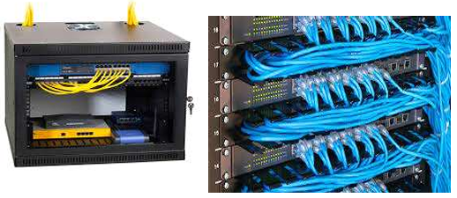
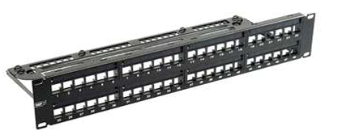
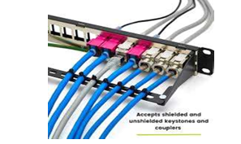
Network Rack Equipment
These racks can house a lot of different types of equipment.
Some of these devices include the following:
Switches
Routers
Modems
Brackets : In networking, brackets typically refer to physical enclosures or mounting devices.
Patch panel: A patch panel provides a way to keep large numbers of cables organized, enabling flexible connectivity into network hardware located in a data center
Repeater

Slide 38
Materials
Network Cables (twisted, coaxial, and Fiber optic)
Trunk : trunk is a communication link that carries multiple data signals or network traffic between devices, typically switches or routers, using VLAN (Virtual Local Area Network) tagging.
Connectors : provides an entry point for network devices such as computers, hubs and routers. These can in turn be differentiated according to their external appearance and connection characteristics.

Slide 39
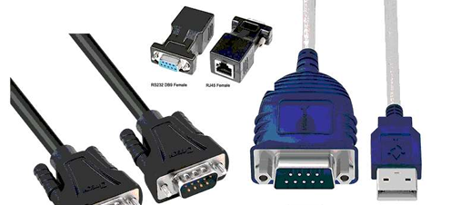
Types of Connectors
Barrel connectors that are used to connect coaxial cables are known as BNC barrel connectors.
Terminator connectors
RJ-45 connectors
DB-9 (RS-232) connectors
Universal serial bus (USB) connectors
Fiber cable connectors
(Some popular connectors are ST, SC, LC, and MTRJ..

